Slide 1
Syntax Analysis

Slide 2
CFG offer significant benefits for both language designers & compiler writers
A grammar gives a precise, yet easy-to-understand, syntactic specification of a programming language.
From certain classes of grammars, we can construct automatically an efficient parser that determines the syntactic structure of a source program.
As a side benefit, the parser-construction process can reveal syntactic ambiguities & trouble spots that might have slipped through the initial design phase of a language.
The structure imparted to a language by a properly designed grammar is useful for translating source programs into correct object code & for detecting errors.
A grammar allows a language to be evolved or developed iteratively, by adding new constructs to perform new tasks.
These new constructs can be integrated more easily into an implementation that follows the grammatical structure of the language.

Slide 3
The Role of the Parser
Parser obtains a string of tokens from the lexical analyzer & verifies that the string of token names can be generated by the grammar for the source language.
Parser report any syntax errors in an intelligible fashion & to recover from commonly occurring errors to continue processing the remainder of the program.
Conceptually, for well-formed programs, the parser constructs a parse tree & passes it to the rest of the compiler for further processing.

Slide 4
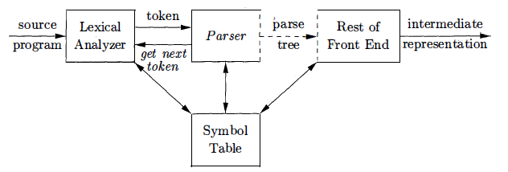
Position of parser in compiler model
Parsing Approach
Top down
Bottom UP

Slide 5

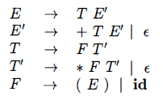

Representative Grammars
Expression grammar (LR): suitable for bottom-up parsing.
Not suitable for top-down parsing (left recursive)
Remove left recursion
Producing ambiguity: a + b * c

Slide 6
Syntax Error Handling
Common programming errors
Lexical errors include misspellings of identifiers, keywords, or operators
the use of an identifier elipseSize instead of ellipseSize – and missing quotes around text intended as a string.
Syntactic errors include misplaced semicolons or extra or missing braces; that is, "{" or "}."
As another example, in C or Java, the appearance of a case statement without an enclosing switch is a syntactic error
Semantic errors include type mismatches between operators & operands.
An example is a return statement in a Java method with result type void.
Logical errors can be anything from incorrect reasoning on the part of the programmer to the use in a C program of the assignment operator = instead of the comparison operator ==.
The program containing = may be well formed; however, it may not reflect the programmer's intent.

Slide 7
Error-Recovery Strategies
Panic-Mode Recovery
Phrase-Level Recovery
Error Productions
Global Correction
See details in the Book

Slide 8
Context-Free Grammars
Grammars systematically describe the syntax of programming language constructs like expressions & statements.
Using a syntactic variable stmt to denote statements & variable expr to denote expressions, the production
stmt → if ( expr ) stmt else stmt

Slide 9
Formal Definition of CFG
1. Terminals (T) are the basic symbols from which strings are formed.
The term "token name" is a synonym for "terminal" and frequently we will use the word "token" for terminal.
Terminals are the first components of the tokens output by the lexical analyzer.
Keywords: if, else, (, )
stmt → if ( expr ) stmt else stmt

Slide 10
stmt → if ( expr ) stmt else stmt
2. Non-terminals (V) are syntactic variables that denote sets of strings.
Non-terminals: stmt, expr
The sets of strings denoted by non-terminals help define the language generated by the grammar.
Nonterminals impose a hierarchical structure on the language that is key to syntax analysis and translation.

Slide 11
stmt → if ( expr ) stmt else stmt
3. Start symbol (S): one non-terminal is distinguished as the start symbol,
the set of strings it denotes is the language generated by the grammar.
Conventionally, the productions for the start symbol are listed first.

Slide 12
stmt → if ( expr ) stmt else stmt
4. Productions (P) of a grammar specify the manner in which the terminals & non-terminals can be combined to form strings. Each production consists of:
(a) A non-terminal called the head or left side of the production; this production defines some of the strings denoted by the head.
(b) The symbol →. Sometimes : : = has been used in place of the arrow.
(c) A body or right side consisting of zero or more terminals and non-terminals.

Slide 13
Example: Grammar for simple arithmetic expressions
expression → expression + term
expression → expression - term
expression → term
term → term * factor
term → term / factor
term → factor
factor → ( expression )
factor → id
Terminals:
id, +, -, *, /, (, )
Non-terminals:
expression, term, factor
Start Symbol
expression

Slide 14
Notational Conventions
1. Terminals:
-Lowercase letters early in the alphabet: a, b, c.
-Operator symbols: +, *
-Punctuation symbols: parentheses, comma,
-Digits: 0, 1, . . . , 9.
-Boldface strings: id, if, each of which represents a single terminal symbol.
2. Non-terminals:
-Uppercase letters early in the alphabet: A, B, C.
-Letter S: start symbol.
-Lowercase, italic: expr, stmt.
-Uppercase letters: E, T, F

Slide 15
5. Lowercase Greek letters, α, β, δ: represent (possibly empty) strings of grammar symbols. Thus , a generic production can be written as A → α, where A-head & α-body.
6. A set of productions A → α₁, A → α₂, ... , A_{k} → α_{k} with a common head A (call them A-productions) , written
A → α₁,| A → α₂,| ... ,| A_{k} → α_{k} Call α₁, α₂, …, α_{k} are the alternatives for A.
3. Uppercase letters late in the alphabet: as X, Y, Z, represent grammar symbols(T or V).
4. Lowercase letters late in the alphabet: u, v, ... ,z, represent (possibly empty) strings of terminals.
7. Unless stated otherwise, the head of the first production is the start symbol.

Slide 16

Example
V: E, T, F
S: E
T: remaining symbols
P: 08

Slide 17
Derivation
A derivation is basically a sequence of production rules, in order to get the input string. During parsing, we take two decisions for some sentential form of input:
Deciding the non-terminal which is to be replaced.
Deciding the production rule, by which, the non-terminal will be replaced.
To decide which non-terminal to be replaced with production rule, we can have two options.
Consider the following example grammar
with 5 productions:

Slide 18
Leftmost derivation order of string:
At each step, we substitute the
leftmost variable

Slide 19
Rightmost derivation order of string:
At each step, we substitute the
rightmost variable

Slide 20
Leftmost derivation of:
Rightmost derivation of:

Slide 21
Derivation Trees
Consider the same example grammar:
And a derivation of:

Slide 22
yield

Slide 23
yield

Slide 24
yield

Slide 25
yield

Slide 26
Derivation Tree
(parse tree)
yield

Slide 27
Sometimes, derivation order doesn’t matter
Leftmost derivation:
Rightmost derivation:
Give same
derivation tree

Slide 28

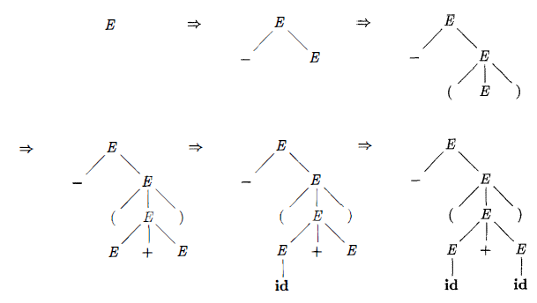
Parse Tree & Derivation -(id+id)
LMD

Slide 29
Ambiguity
A grammar that produces more than one parse tree for some sentence is said to be ambiguous.
an ambiguous grammar is one that produces more than
one leftmost derivation or
more than one rightmost derivation

Slide 30
Grammar for mathematical expressions
Example strings:
Denotes any number

Slide 31
A leftmost derivation
for

Slide 32
Another
leftmost derivation
for

Slide 33
Two derivation trees
for

Slide 34
take

Slide 35
Good Tree
Bad Tree
Compute expression result
using the tree

Slide 36
Two different derivation trees
may cause problems in applications which
use the derivation trees:
Evaluating expressions
In general, in compilers
for programming languages

Slide 37
Ambiguous Grammar:
A context-free grammar is ambiguous
if there is a string which has:
two different derivation trees
or
two leftmost derivations
(Two different derivation trees give two
different leftmost derivations and vice-versa)

Slide 38
Example:
this grammar is ambiguous since
string
has two derivation trees

Slide 39
this grammar is ambiguous also because
string
has two leftmost derivations

Slide 40
Another ambiguous grammar:
IF_STMT
if EXPR then STMT
if EXPR then STMT else STMT
Terminals
Variables
Very common piece of grammar
in programming languages

Slide 41
If expr1 then if expr2 then stmt1 else stmt2
IF_STMT
if
expr1
then
STMT
if
expr2
then
stmt1
else
stmt2
Two derivation trees
IF_STMT
if
expr1
then
STMT
else
stmt2
if
expr2
then
stmt1

Slide 42
In general, ambiguity is bad
and we want to remove it
Sometimes it is possible to find
a non-ambiguous grammar for a language
But, in general ιt is difficult to achieve this

Slide 43
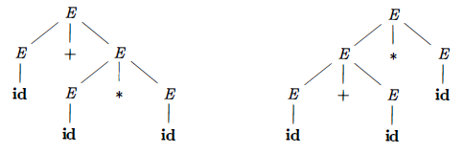

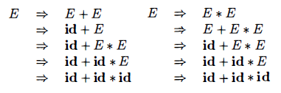
id+id*id
Two LMD

Slide 44
Lexical Versus Syntactic Analysis
Everything that can be described by a regular expression can also be described by a grammar.
Why use regular expressions to define the lexical syntax of a language?

Slide 45
Several reasons
1. Separating the syntactic structure of a language into lexical and Nonlexical parts provides a convenient way of modularizing the front end of a compiler into two manageable-sized components.
2. The lexical rules of a language are frequently quite simple, and to describe them we do not need a notation as powerful as grammars.
3. Regular expressions generally provide a more concise and easier-to-understand notation for tokens than grammars.
4. More efficient lexical analyzers can be constructed automatically from regular expressions than from arbitrary grammars.
RE: most useful for describing the structure of constructs such as identifiers, constants, keywords, and white space.
CFG: most useful for describing nested structures such as balanced parentheses, matching begin-end’s, corresponding if-then-else’s
Nested structures cannot be described by regular expressions.

Slide 46

Eliminating Ambiguity
Sometimes an ambiguous grammar can be rewritten to eliminate the ambiguity.
As an example, we shall eliminate the ambiguity from the following “dangling-else” grammar:
"other" stands for any other statement.

Slide 47
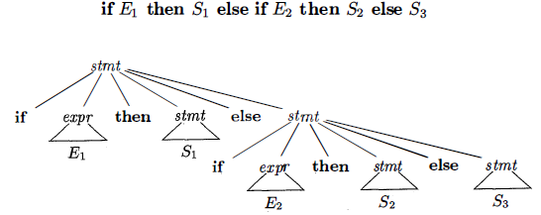
Compound conditional statement:
Parse Tree
Ambiguous or non-ambiguous??

Slide 48
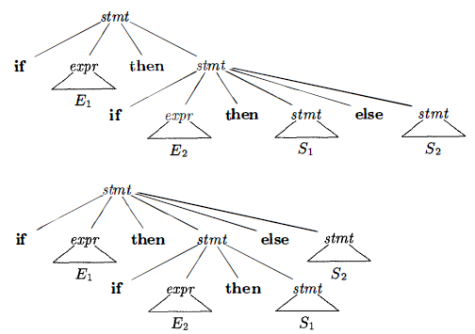
Lets try:
Which one is the best??
"Match each else with the
closest unmatched then”

Slide 49
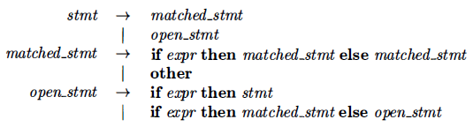
Rewrite the dangling-else grammar:
%% ... more grammar rules ...
statement : matched | unmatched ;
matched : IF '(' expression ')' matched ELSE matched | other_statement ;
unmatched : IF '(' expression ')' statement | IF '(' expression ')' matched ELSE unmatched ;
other_statement : iteration_statement | compound_statement | ... other alternatives ... ; ... more grammar rules ... %%
Ideas: a statement appearing between a then and an else must be "matched" ; -the interior statement must not end with an unmatched or open then.
A matched statement is either an if-then-else statement containing no open statements or it is any other kind of unconditional statement.
Only one Parse Tree

Slide 50
A successful example:
Equivalent
Ambiguous
Grammar
Non-Ambiguous
Grammar
generates the same
language

Slide 51
Unique
derivation tree
for

Slide 52
Elimination of Left Recursion
A grammar is left recursive if it has a non-terminal A such that there is a derivation A ⇒ A α for some string α .
Top-down parsing methods cannot handle left-recursive grammars, so a transformation is needed to eliminate left recursion.
A → A α | β
replaced by the non-left-recursive productions:
A → β A'
A' → α A' | ε
without changing the strings derivable from A.

Slide 53
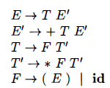

Example : The non-left-recursive expression grammar,
eliminating immediate left recursion from the expression grammar.
The left-recursive pair of productions
E → E + T | T are replaced by
E →T E' and E' → +T E‘ | ε

Slide 54

Immediate left recursion can be eliminated by the following technique, which works for any number of A-productions.
First, group the productions as
where no β_{i} begins with an A. Then, replace the A-productions by

Slide 55

The non-terminal A generates the same strings as before but is no longer left recursive.
This procedure eliminates all left recursion from the A and A' productions (provided no α_{i} is ε) , but it does not eliminate left recursion involving derivations of two or more steps.
The non-terminal S is left recursive because
S ⇒ Aa ⇒ Sda
but it is not immediately left recursive.

Slide 56
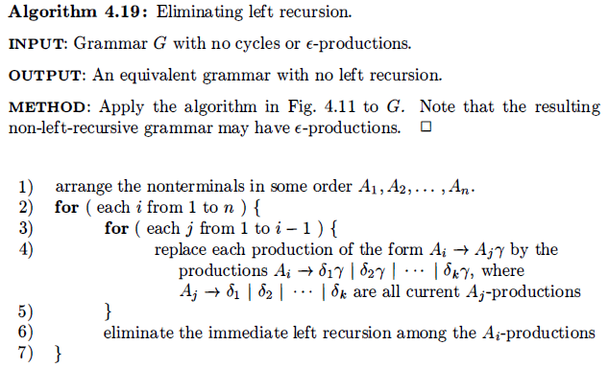

Slide 57


Example
Order the non-terminals: S, A.
No immediate left recursion among the S-productions, so nothing happens during the outer loop for i =1.
For i = 2, Substitute for S in A→S d to obtain the following A-productions: A → Ac I Aad I bd I ε
Eliminating the immediate left recursion:

Slide 58
Left Factoring
Left factoring is a grammar transformation that is useful for producing a grammar suitable for predictive, or top-down, parsing.
When the choice between two alternative A-productions is not clear, we may be able to rewrite the productions to defer the decision until enough of the input has been seen that we can make the right choice.

Slide 59

if we have the two productions
on seeing the input if, we cannot immediately tell which production to choose to expand stmt.

Slide 60

if A → αβ₁ | αβ₂ are two A-productions, & input begins with a nonempty string derived from α,
Whether to expand A to αβ₁ or αβ₂!!!
We may defer the decision by expanding A to αA`
Then, after seeing the input derived from α, Expand A` to β₁ or β₂.
Left-factored:

Slide 61
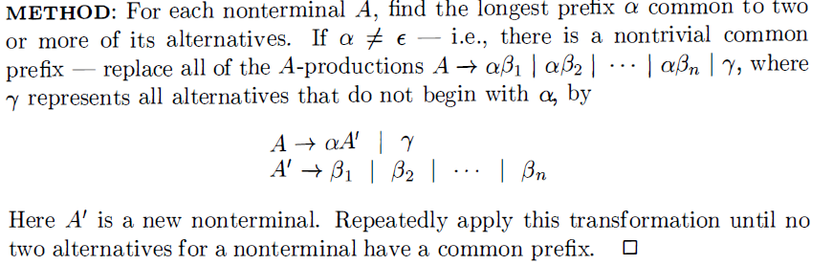
Algorithm: Left factoring a grammar. INPUT: Grammar G OUTPUT: An equivalent left-factored grammar.

Slide 62

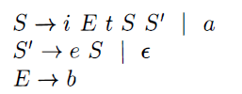

Example
α
Left-factored grammars:
Here, i, t, and e stand for if, then, and else;
E: conditional expression S: Conditional statement
Longest common: iEtS

Slide 63
Top-Down Parsing
Constructing a parse tree
Starting from the root and creating the nodes of the parse tree in preorder (depth-first)
Equivalent to a leftmost derivation

Slide 64
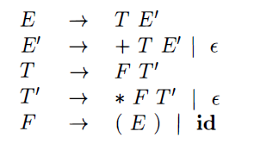
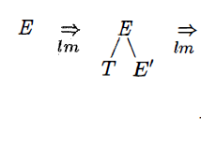
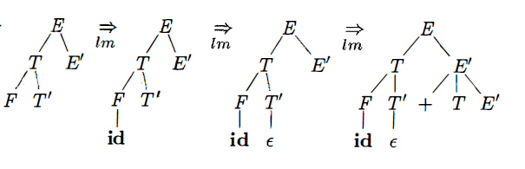
Input: id+id*id

Slide 65
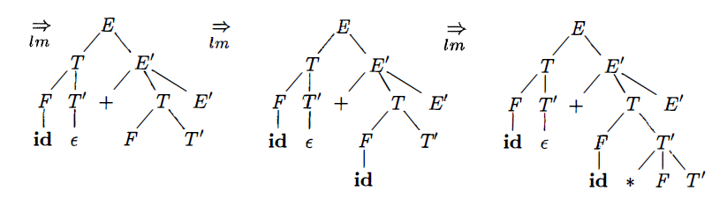
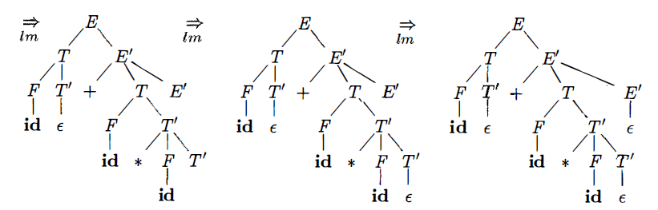

Slide 66
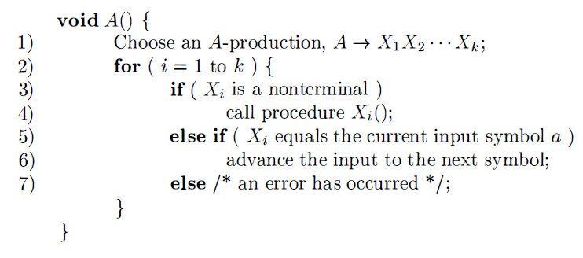
Recursive-Descent Parsing

Slide 67
A recursive-descent parsing program consists of a set of procedures, one for each nonterminal.
Execution begins with the procedure for the start symbol, which halts and announces success if its procedure body scans the entire input string.
General recursive-descent may require backtracking; that is, it may require repeated scans over the input.
However, backtracking is rarely needed to parse programming language constructs, so backtracking parsers are not seen frequently.
Even for situations like natural language parsing, backtracking is not very efficient

Slide 68
Modify Recursive-Descent Parsing
To allow backtracking, recursive decent parsing algorithm needs to be modified.
First, we cannot choose a unique A-production at line ( 1 ) , so we must try each of several productions in some order.
Then, failure at line (7) is not ultimate failure, but suggests only that we need to return to line (1) and try another A-production.
Only if there are no more A-productions to try do we declare that an input error has been found.
In order to try another A-production, we need to be able to reset the input pointer to where it was when we first reached line (1) .
Thus, a local variable is needed to store this input pointer for future use.

Slide 69

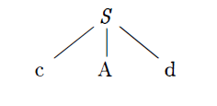
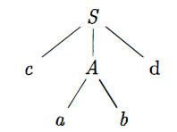
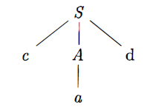
w=cad
Match for the second input symbol, a, so advance the input pointer to d, the third input symbol,
-compare d against the next leaf, labeled b.
-Since b does not match d,
-report failure and go back to A to see whether there is another alternative for A that has not been tried
In going back to A, Reset the input pointer to position 2 , the position it had when we first came to A,
-which means that the procedure for A must store the input pointer in a local variable.

Slide 70
FIRST and FOLLOW
The construction of both top-down and bottom-up parsers is aided by two functions:
FIRST
FOLLOW,
During top-down parsing, FIRST and FOLLOW allow us to choose which production to apply, based on the next input symbol.

Slide 71
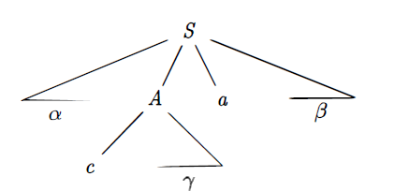
FIRST
Define FIRST(α), where α is any string of grammar symbols, to be the set of terminals that begin strings derived from α.
If α ⇒* ε, then ε is also in FIRST(α).
A ⇒* cγ,
FIRST(A) ={c}

Slide 72
FOLLOW
FOLLOW(A) for non-terminal A to be the set of terminals a that can appear immediately to the right of A in some sentential form ; that is; the set of terminals a such that there exists a derivation of the form S ⇒* αAaβ, for some α and β.
Note that there may have been symbols between A & a, at some time during the derivation, but if so, they derived ε & disappeared.
If A can be the rightmost symbol in some sentential form, then $ is in FOLLOW(A) ;
$ is a special "endmarker" symbol that is assumed not to be a symbol of any grammar.

Slide 73
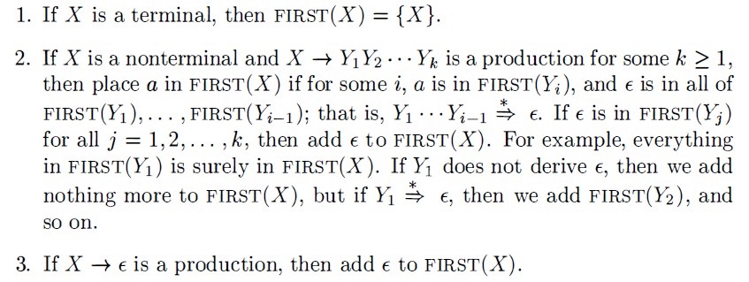
To compute FIRST(X) for all grammar symbols X, apply the following rules until no more terminals or ε can be added to any FIRST set .

Slide 74
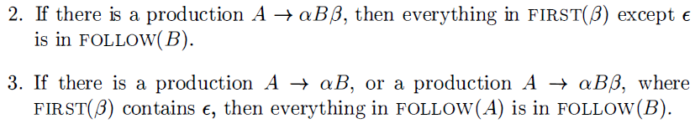
To compute FOLLOW(A) for all non-terminals A, apply the following rules until nothing can be added to any FOLLOW set.

Slide 75
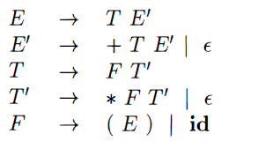
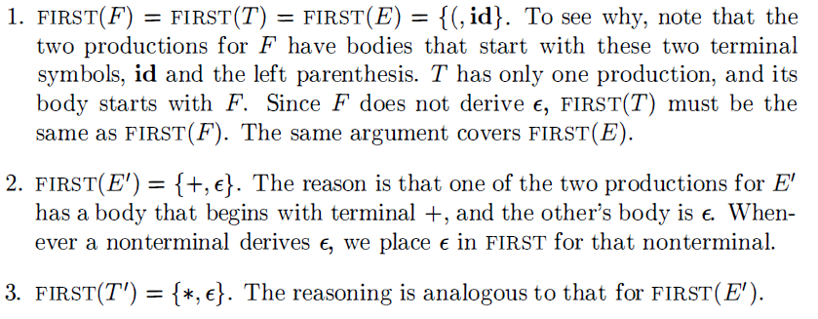

Slide 76
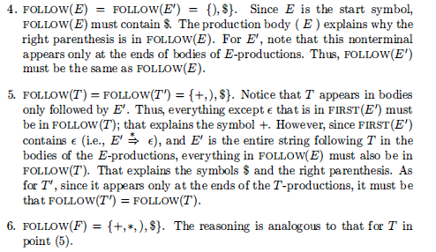

Slide 77
LL ( 1 ) Grammars
Predictive parsers (recursive-descent) needing no backtracking,
can be constructed for a class of grammars called LL(1):
"L" : for scanning the input from left to right,
"L" : for producing a leftmost derivation,
“1“: for using one input symbol of look-ahead at each step

Slide 78
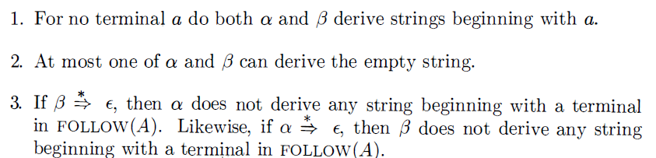
A grammar G is LL(1) if and only if whenever A→α|β are two distinct productions of G, the following conditions hold:

Slide 79
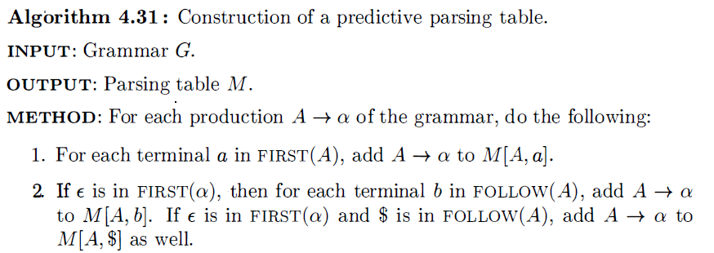


Slide 80
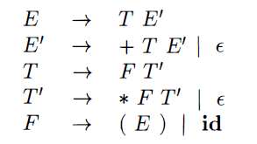
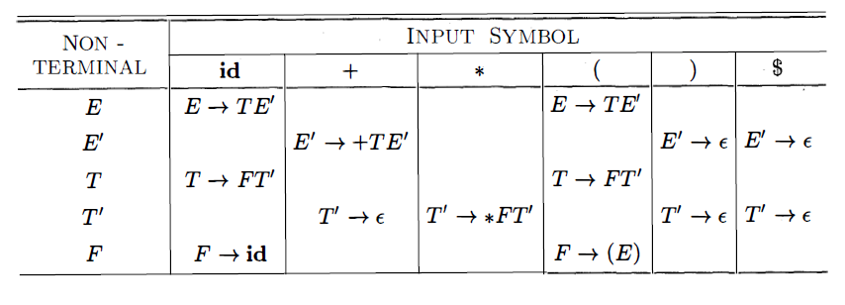
FIRST(F)=FIRST(T)=FIRST(E)={(, id}
FIRST (E`) = {+, ε}
FIRST(T`) = {*, ε}
FOLLOW(E)=FOLLOW(E`) ={ ),$}
FOLLOW(T)=FOLLOW(T`) ={+, ),$}
FOLLOW(F)= {+, *, ),$}

Slide 81
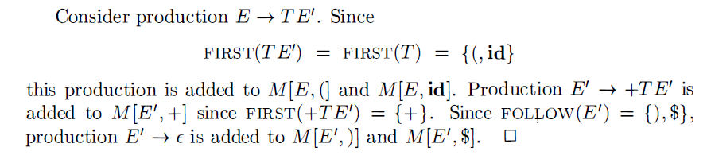

Slide 82

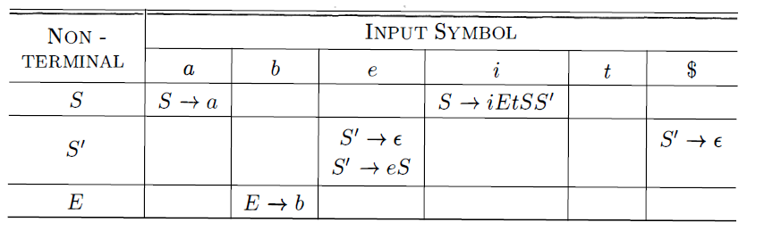
FIRST(S)={i,a} FIRST(S’)={e,€} FIRST(E)=b
FOLLOW(S)={e,$} FOLLOW(S’)={e,$} FOLLOW(E)={t}
Ambiguous (multiple Entry)

Slide 83
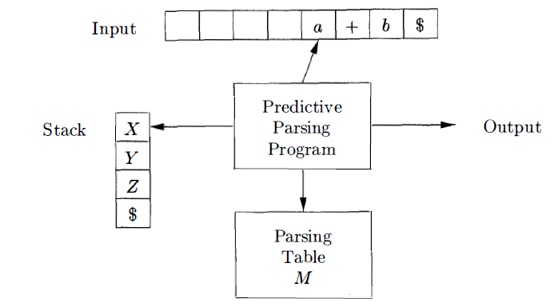
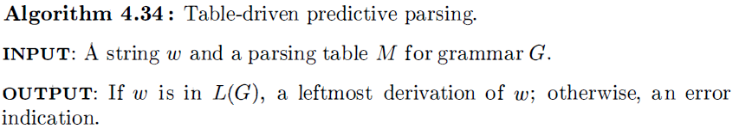
Non-recursive Predictive Parsing

Slide 84
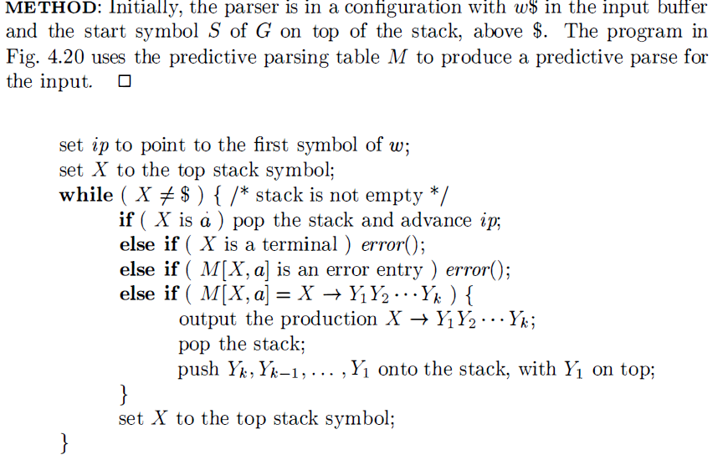

Slide 85
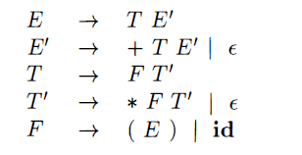
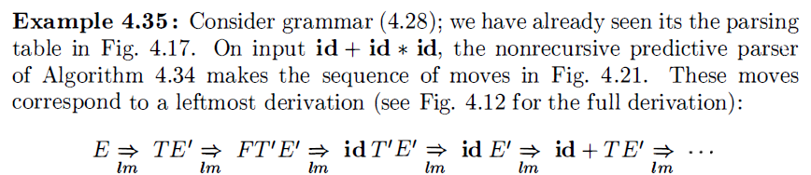

Slide 86
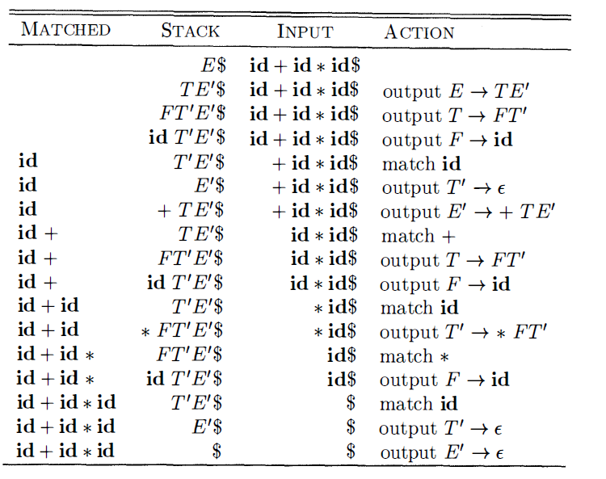

Slide 87
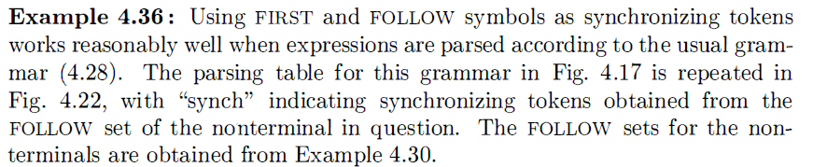
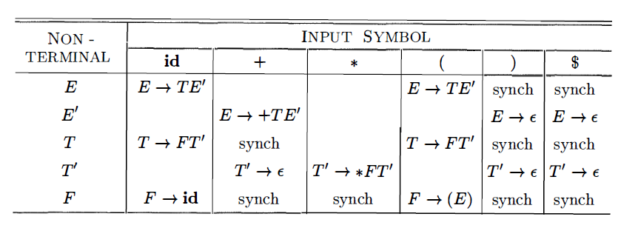
Error Recovery in Predictive Parsing

Slide 88
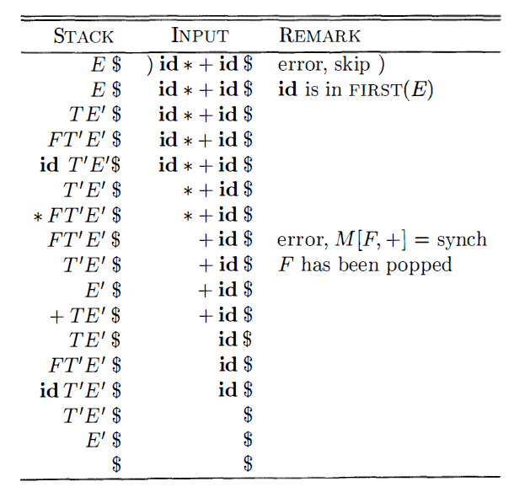

Slide 89
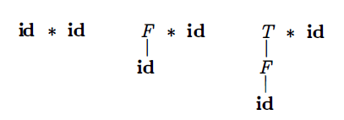
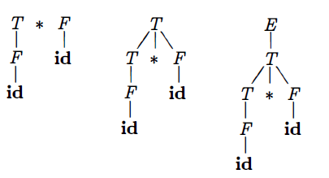
Bottom-Up Parsing
Shift
Reduce
Algorithm

Slide 90
Reductions
process of "reducing" a string w to the start symbol of the grammar.
At each reduction step, a specific substring matching the body of a production is replaced by the non-terminal at the head of that production.
The key decisions:
when to reduce
what production to apply

Slide 91

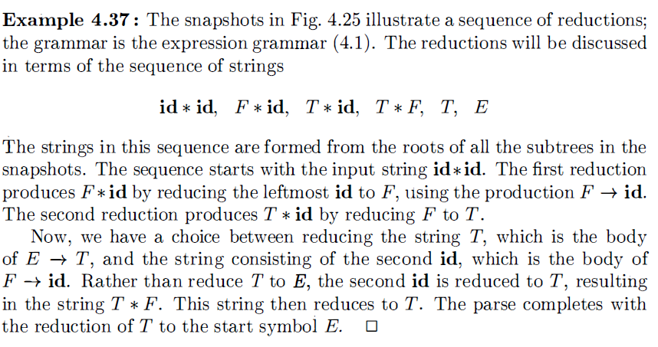
Reductions

Slide 92
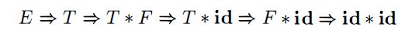
By definition, a reduction is the reverse of a step in a derivation
The goal of bottom-up parsing is therefore to construct a derivation in reverse.
This derivation is in fact a rightmost derivation.

Slide 93
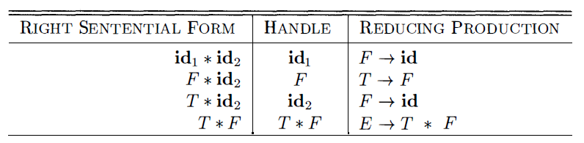
Handle Pruning
Bottom-up parsing during a left-to-right scan of the input constructs a rightmost derivation in reverse.
Informally, a "handle" is a substring that matches the body of a production,
and whose reduction represents one step along the reverse of a rightmost derivation.

Slide 94
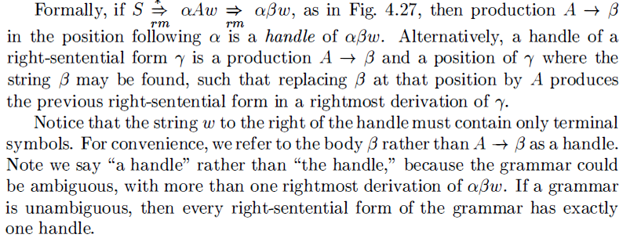
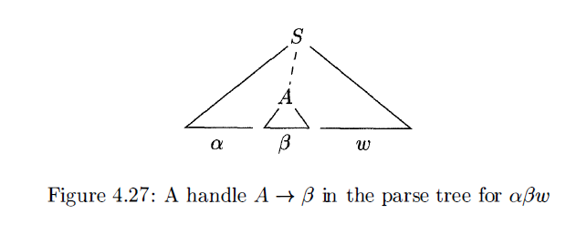
A Handle

Slide 95
Shift Reduce Parsing
Shift-reduce parsing is a form of bottom-up parsing in which a stack holds grammar symbols and an input buffer holds the rest of the string to be parsed.
As we shall see, the handle always appears at the top of the stack just before it is identified as the handle.
We use $ to mark the bottom of the stack and also the right end of the input.
Conventionally, when discussing bottom-up parsing, we show the top of the stack on the right, rather than on the left as we did for top-down parsing.

Slide 96
Initially, the stack is empty, and the string w is on the input, as follows
STACK INPUT
$ w$
During a left-to-right scan of the input string, the parser shifts zero or more input symbols onto the stack, until it is ready to reduce a string β of grammar symbols on top of the stack.
It then reduces β to the head of the appropriate production.
The parser repeats this cycle until it has detected an error or until the stack contains the start symbol and the input is empty:
STACK INPUT
$ S $

Slide 97
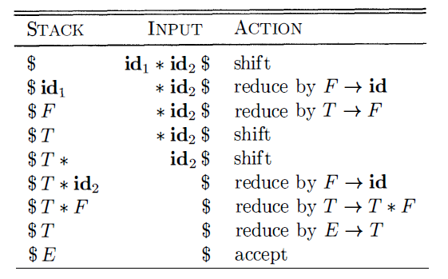
Shift-Reduce Parsing

Slide 98



Slide 99
Why LR Parsers?
LR parsers are table-driven, much like the nonrecursive LL parsers of Section
4.4.4. A grammar for which we can construct a parsing table using one of
the methods in this section and the next is said to be an LR grammar. Intuitively,
for a grammar to be LR it is sufficient that a left-to-right shift-reduce
parser be able to recognize handles of right-sentential forms when they appear
on top of the stack.
LR parsing is attractive for a variety of reasons:

Slide 100



Slide 101
The principal drawback of the LR method is that it is too much work to
construct an LR parser by hand for a typical programming-language grammar.
A specialized tool, an LR parser generator, is needed. Fortunately, many such
generators are available, and we shall discuss one of the most commonly used
ones, Yacc , in Section 4.9. Such a generator takes a context-free grammar and
automatically produces a parser for that grammar. If the grammar contains
ambiguities or other constructs that are difficult to parse in a left-to-right scan
of the input, then the parser generator locates these constructs and provides
detailed diagnostic messages.

Slide 102

The LR-Parsing Algorithm

Slide 103



Slide 104



Slide 105


Slide 106


